Slide 1
From chest to hand X-rays:
Transfer learning for skeletal age prediction
PyData Zurich Meetup, November 1st, 2018
Joel Niklaus, cand. MSc CS, University of Bern
Lukas Zbinden, cand. MSc CS, University of Fribourg

Slide 2
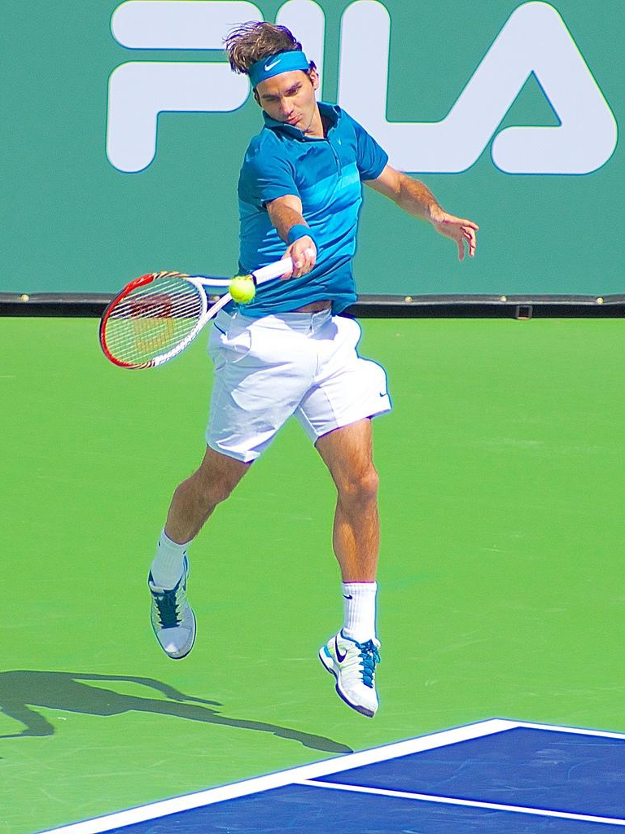
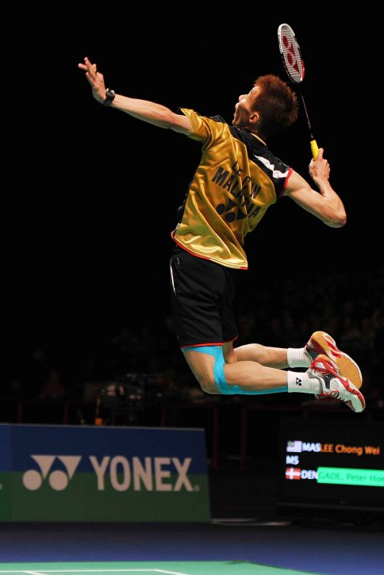
https://www.flickr.com/photos/jfawcette/7006682435
https://hype.my/2016/108000/leechongwei-malaysian-shuttler-records-fastest-smash-in-badminton-history/
Notes:
Lee Chong Wei 408km/h fastest badminton smash
transfer knowledge between different racket sports

Slide 3
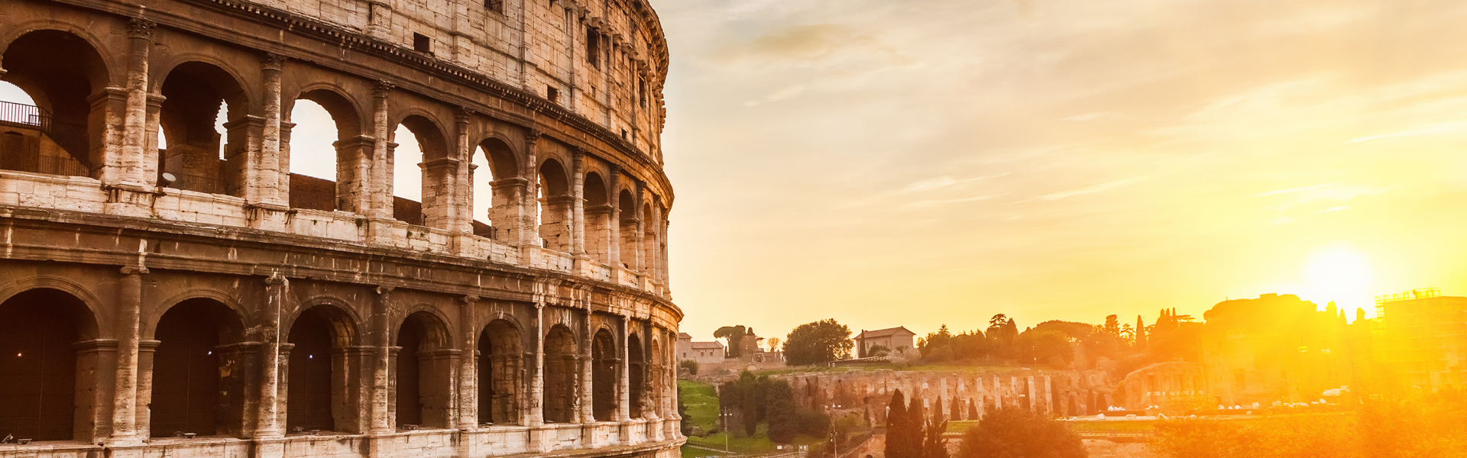

https://www.fluege.de/Katalog/Rom/Flug-445
https://paris.ticketbar.eu/de/home/
Notes:
transfer also between languages
both successors of the latin language
similar grammatical constructs and many similar words

Slide 4
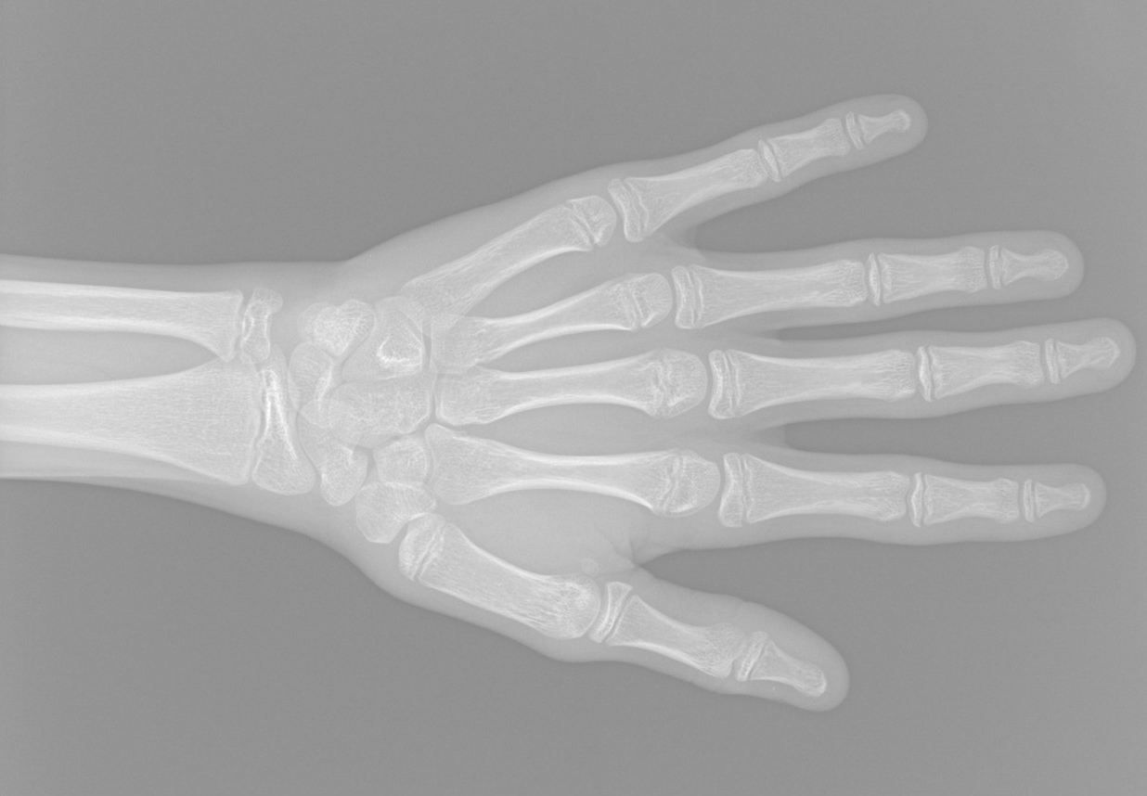
https://www.16bit.ai/blog/ml-and-future-of-radiology
Notes:
165 months, 13 years 9 months
RSNA competition last year as basis for our project
idea: apply transfer learning. like roger federer and the italian person, we expect the neural net to perform better when it knows xray images

Slide 5
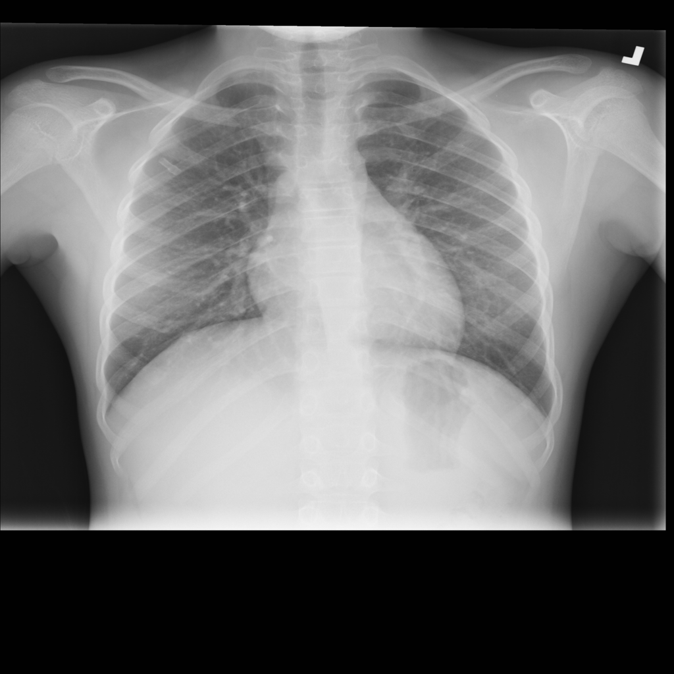
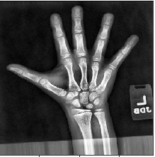
From chest to hand X-rays?
?
112’120x
14’236x
https://arxiv.org/pdf/1712.06957.pdf
Notes:
dataset might be too small to train a deep model
an interesting property of deep NN is that
https://youtu.be/_2EHcpg52uU?t=169
same architecture required for transfer learning
-> both tasks have an image as input
-> this is a setting where TL makes sense: lot of data for the problem we’re transfering from and relatively less data for the problem we’re transfering to
-> we have reason to suspect that low level features from chest could be helpful for learning bone age

Slide 6
Challenge
Skeletal age prediction based on pediatric hand X-rays
2017 RSNA global ML competition to develop best model
winner: 16BitNet with mean absolute error (MAE) of 4.265 months
Radiologist performance: MAE of 7.32 months
Our idea: apply transfer learning
Notes:
comment noneffective results for image preprocessing, no further mention

Slide 7
Transfer Learning Recap
Transfer learning and domain adaptation refer to the situation where what has been learned in one setting … is exploited to improve generalization in another setting
— Page 526, Deep Learning, 2016
https://machinelearningmastery.com/transfer-learning-for-deep-learning/
Notes:
Transfer learning discussed in last meetup

Slide 8
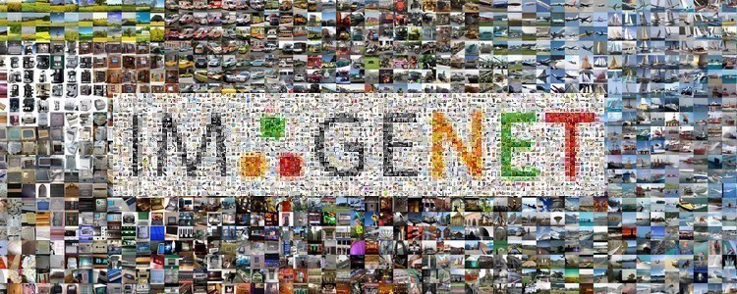
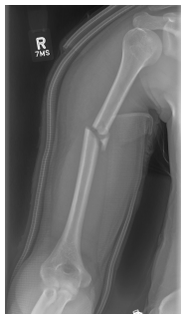
Transfer Learning Recap
Example from ImageNet dataset (for MURA)
“The weights of the network were initialized with weights from a model pretrained on ImageNet.”
1’300’000x
40’561x
MURA: Large Dataset for Abnormality Detection in Musculoskeletal Radiographs (Pranav Rajpurkar et al, Dec 2017)

Slide 9
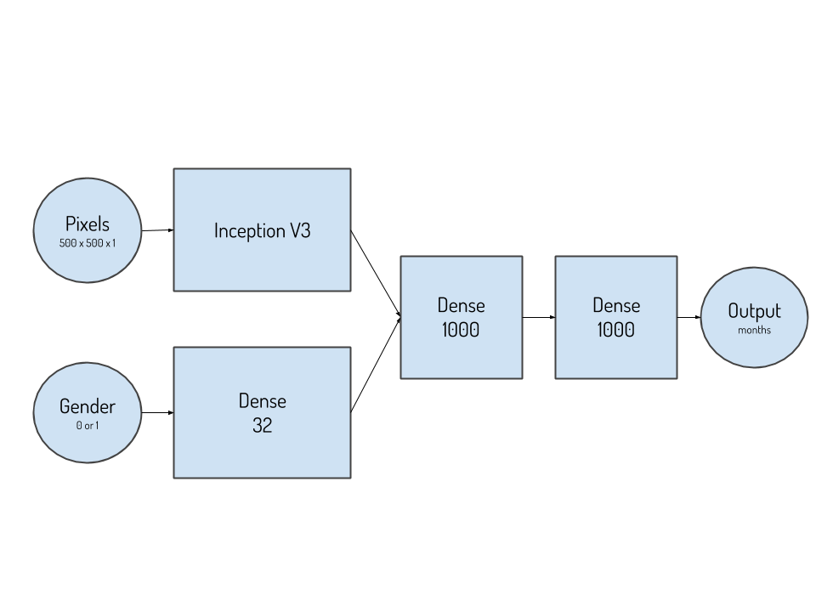
Method
Architecture (by 16BitNet)
https://www.16bit.ai/blog/ml-and-future-of-radiology
Notes:
winner of RSNA competition
InceptionV3 is 48 layers deep

Slide 10
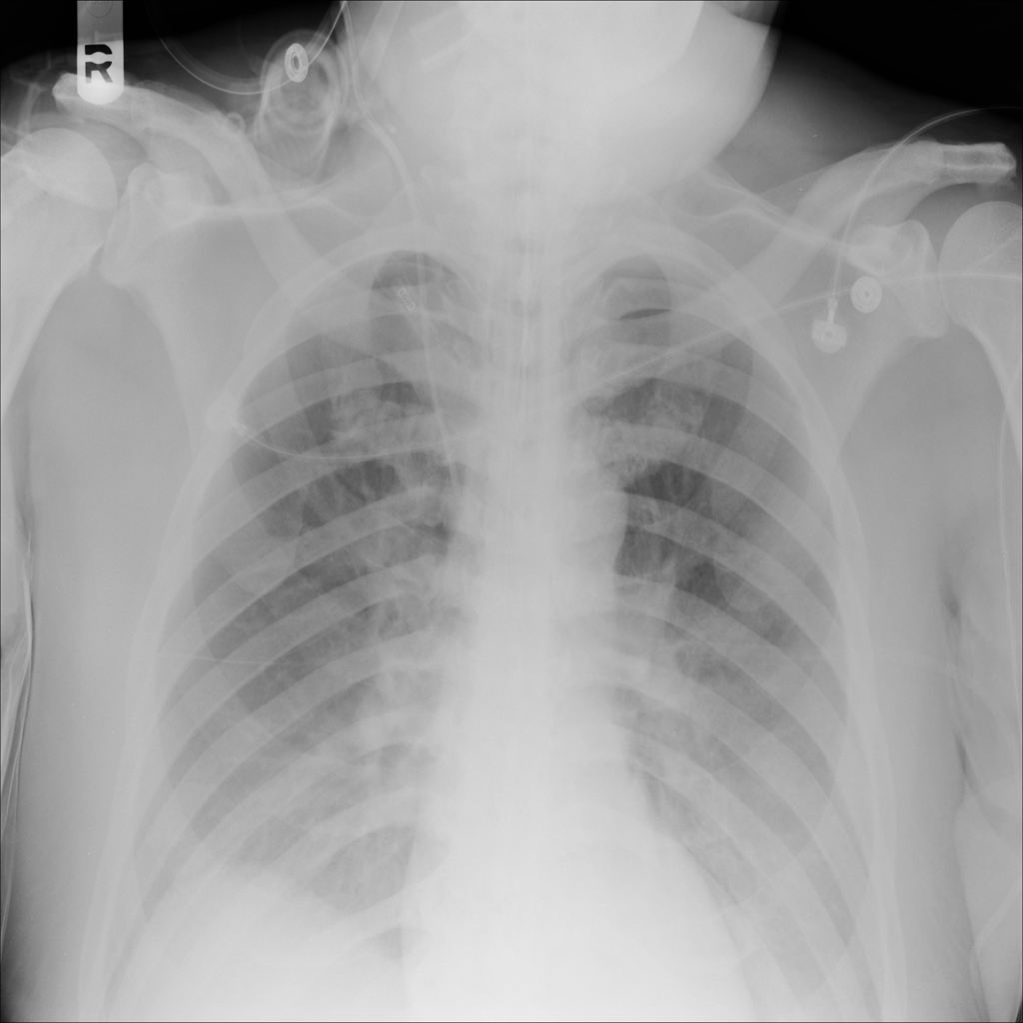
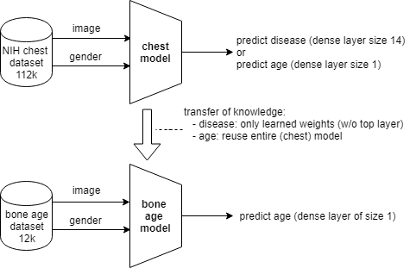

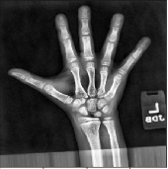
Method
Transfer learning from NIH chest dataset
Notes:
mention finetuning

Slide 11
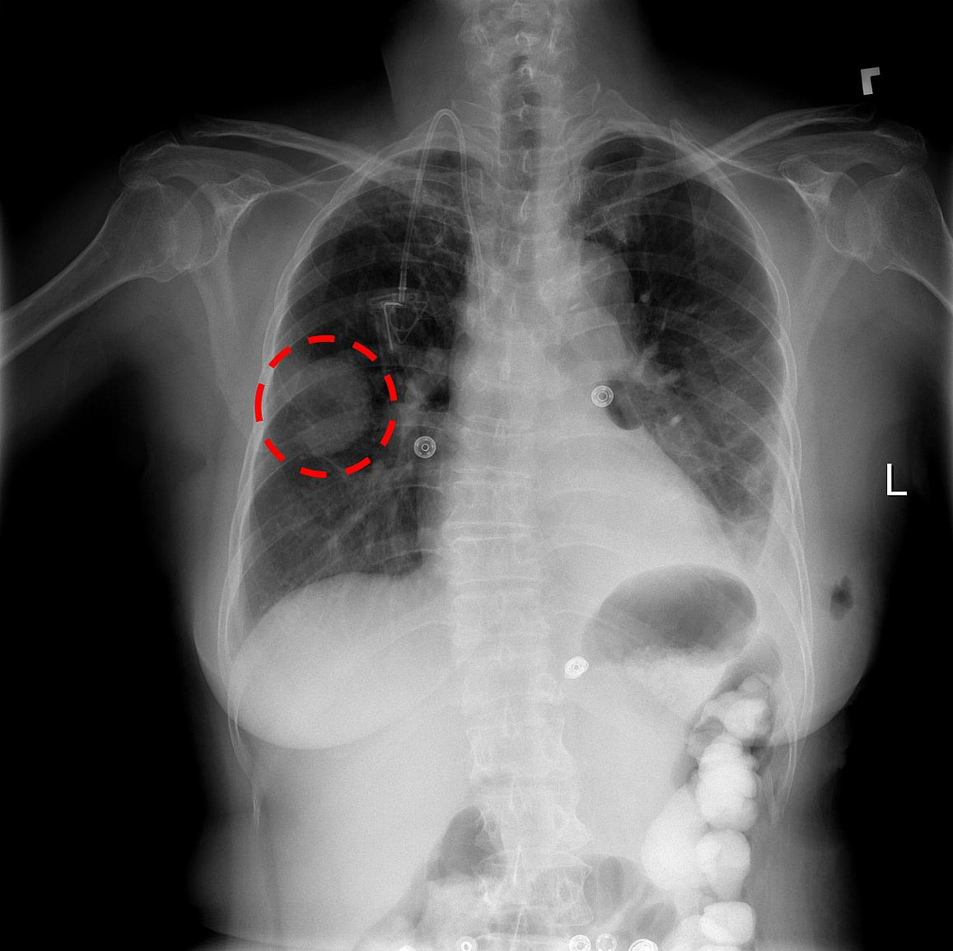
NIH chest X-Ray: 112’120 images
https://www.nih.gov/news-events/news-releases/nih-clinical-center-provides-one-largest-publicly-available-chest-x-ray-datasets-scientific-community
Notes:
dashed line marking a disease
used to classify for diseases
but for us only age is relevant

Slide 12
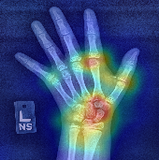
RSNA hand X-Ray: 14’236
http://rsnachallenges.cloudapp.net/competitions/4
Notes:
pediatric dataset

Slide 13
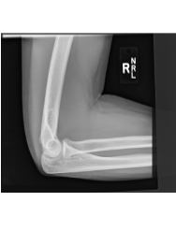
MURA arm X-Ray: 40’561 images
https://stanfordmlgroup.github.io/competitions/mura/
Notes:
Elbows, fingers, forearms, shoulders, wrists
Not used in our experiments because not available yet, but good for more transfer learning

Slide 14
Experiments
Keras on Tensorflow
Dataset split training <-> validation 4:1
Data augmentation: left-right flip, random shift (20%), random rotation (20 degree), zoom (0.2)
Batch size 16
Adam optimizer with initial learning rate 1e-3
SGD optimizer with learning rate 1e-4 for finetuning
Learning rate decays to 0.01 of original learning rate
MAE (mean absolute error) loss function
Setup
Notes:
keras highlevel library for fast prototyping
small batch size because of large model, large images and limited memory
adam for training on chest set
sgd for finetuning on target set

Slide 15
Experiments
Pretraining on ImageNet vs. random initialization
Experiment | Epochs | MAE
Imagenet | 50 | 76.8
Imagenet | 250 | 8.8
No Transfer Learning, random initialization | 250 | 10.8
Notes:
needs many epochs to achieve good performance

Slide 16
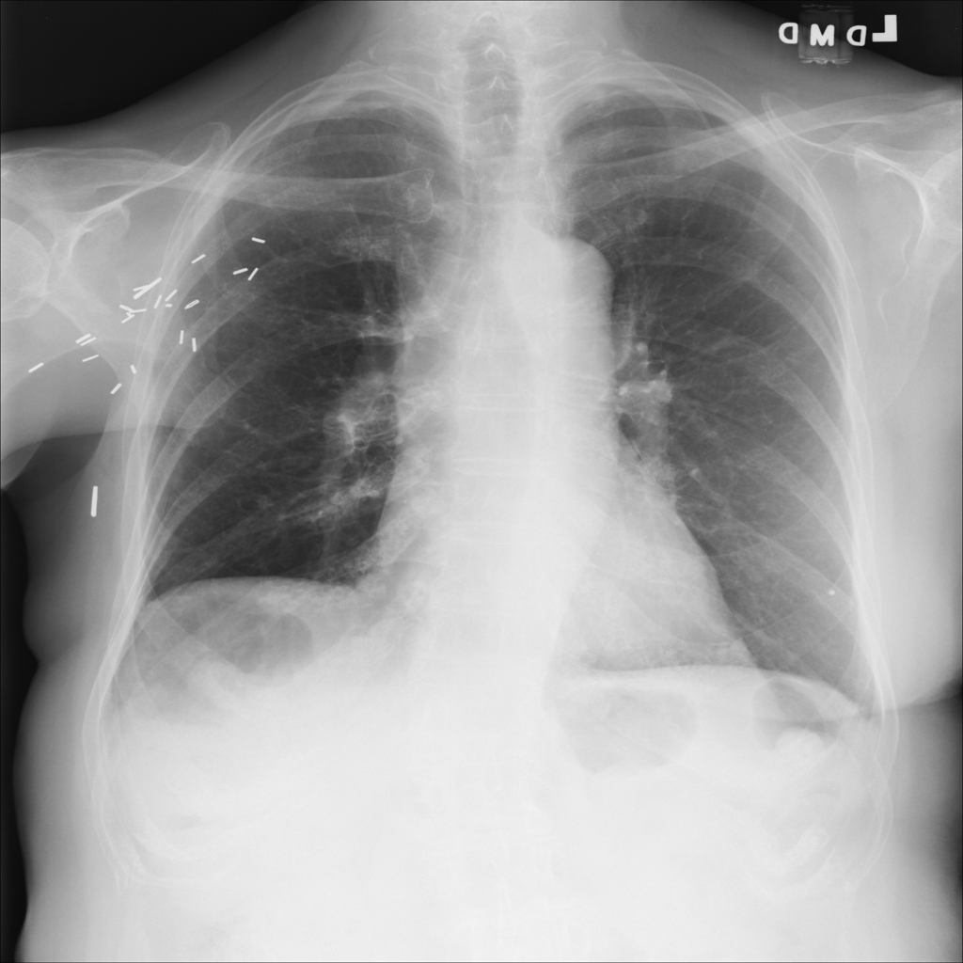
Experiments
Predict chest within hand X-Ray age range only (0-20 years)
87 years, female
12 years, female
Notes:
on the one hand: fits hand xray set better
reason: model gets more confused when training with all ages
reason: perhaps chest structure and bones in general change significantly with increasing age
on the other hand: data only 1500 images instead of 90000 → transfer learning does not make any sense

Slide 17
Experiments
Chest 0-20 years (train: 1560 images), Finetuning
Experiment | Epochs | MAE
Chest 0-20yrs., 30 layers finetuning | 50 | 33.9
Chest 0-20yrs., 100 layers finetuning | 50 | 37
Chest 0-20yrs., 100 layers finetuning | 250 | 41.8
Chest 0-20yrs., 50 layers finetuning | 250 | 34.5
Chest 0-20yrs., 20 layers finetuning | 250 | 36.7
Chest 0-20yrs., 30 layers finetuning | 250 | 35.8

Slide 18
Experiments
Chest 0-100 years (train: 89696 images), Finetuning
Experiment | Epochs | MAE
Chest 0-100yrs, 3 layers finetuning | 250 | running...
Chest 0-100yrs, all layers finetuning | 250 | running...
Notes:
running still 3 and a half days
other experiments were finished much faster

Slide 19
Conclusions, Future Work
Pretraining with Imagenet confirmed
chest X-Rays vs. ImageNet pending
Code available: https://github.com/lukaszbinden/pediatric-bone-age-prediction
→ simple framework to run experiments
Use more recent deep models
hyperparameter tuning
experiment with MURA Dataset
Notes:
Mura dataset not available at time of our experiments: could serve as additional transfer learning dataset

Slide 20
Questions || Comments

Slide 22
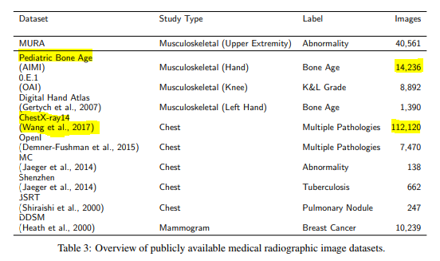
Transfer Learning
transfer
learning?
Source: https://arxiv.org/pdf/1712.06957.pdf

Slide 23
node02: imagenet init, ohne TL (done ~8mae)
node02: random init, ohne TL
node03: TL chest full dataset, finetuning all layers
node06: TL chest full dataset, finetuning last 3 layers

